Slide 1
The IEEE MAC Sub-Layer

Slide 2
Introduction
Multiple, independent computers must coordinate to access a shared medium
Three approaches:
Modified form of Multiplexing
Controlled access
Random access

Slide 3
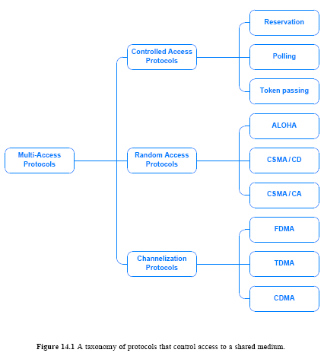
Fig. 14.1
A Taxonomy of Mechanisms for Multi-Access

Slide 4
Channel Allocation
A mapping between a given communication and a channel in the underlying transmission system
Static Channel Allocation
Fixed frequency for a set of communicating entities
Dynamic Channel Allocation
A set of entities using the network varies over time: e.g. cellphone

Slide 5
Channelization Protocols
FDMA: Frequency Division Multi-Access
Extension of FDM
Allow independent stations to choose carrier frequencies
TDMA: Time Division Multi-Access
Extension of TDM
Time slice is allocated dynamically – first come first serve
CDMA: Code Division Multi-Access

Slide 6
Controlled Access Protocols
Polling: Use of centralized controller
Round Robin Order
Priority Order: e.g. higher order for IP phone than PC
Reservation: submit a request for the next round
Often used with satellite transmission
Form a list of stations and allow them to transmit
Toke Passing: stations circulate a token

Slide 7
Random Access Protocols
ALOHA: historic protocol used in an early radio network; not used in real networks
Use of inbound and outbound frequencies in ALOHAnet
CSMA/CD:
Basis for Ethernet; most widely used
CSMA/CA:
Basis for Wi-Fi wireless networks

Slide 8
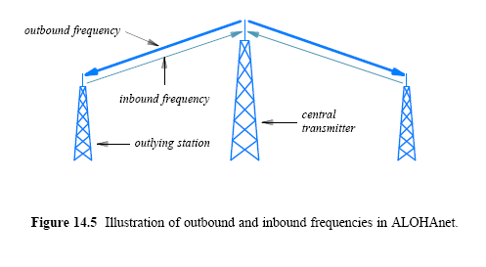
Random Access Protocols - ALOHA

Slide 9
ALOHA
When transmitting:
it transmits the packet on the inbound frequency
the central transmitter repeats the transmission on the outbound frequency (which all stations can receive)
Checking transmission
listens to the outbound channel
if a copy of its packet arrives, moves to the next packet
if no copy arrives, waits a short time and tries again

Slide 10
Interference may cause transmission failure
simultaneously transmission cause collision
The transmissions will be garbled
The protocol handles a collision
by requiring a sender to retransmit each lost packet

Slide 11
CSMA(Carrier Sense Multiple Access)
No central control managing when computers transmit on ether
Ethernet employs CSMA to coordinate transmission among multiple attached computers
Carrier Sense with Multiple Access
Multiple access - multiple computers are attached and any can be transmitter
Carrier sense - computer wanting to transmit tests ether for carrier before transmitting

Slide 12
Collision detection – CD (IEEE 802.3)
Even with CSMA, two computers may transmit simultaneously
3 states are possible – contention, transmit, idle
Contention period is twice the time that the signal travels 2 farthest stations
Both check ether at the same time, find it idle, and begin transmitting
Window for transmission depends on speed of propagation in ether

Slide 13
Collision detection – CD (IEEE 802.3)
Signals from two computers will interfere with each other
Overlapping frames is called a collision
No harm to hardware
Data from both frames is garbled
Send out collision presence signal

Slide 14
Ethernet CD
Ethernet interfaces include hardware to detect transmission
Monitors outgoing signal
Garbled signal is interpreted as a collision
After collision is detected, computer stops transmitting

Slide 15
Recovery from collision
Computer that detects a collision sends special signal to force all other interfaces to detect collision
Computer then waits for Ether to be idle before transmitting
If both computers wait same length of time, frames will collide again
Standard specifies maximum delay, and both computers choose random delay less than maximum

Slide 16
Recovery from collision
After waiting, computers use carrier sense to avoid subsequent collision
Computer with shorter delay will go first
Other computers may transmit first

Slide 17
Binary Exponential backoff
Even with random delays, collisions may occur
Especially likely with busy segments
Computers double delay with each subsequent collision
Reduces likelihood of sequence of collisions
After i collisions, a random number between 0 and 2^{i} –1 is chosen
K * 51.2 μs, where k is the random number between 0 and 2^{i} – 1
When i = 3, k is between 0 and 2³ - 1

Slide 18
Limited connectivity with wireless
In contrast with wired LAN, not all participants may be able to reach each other
Low signal strength
Propagation blocked by walls, etc.
Can't depend on CD; not all participants may hear
Wireless LANs use a modified access protocol known as CSMA with Collision Avoidance (CSMA/CA)

Slide 19
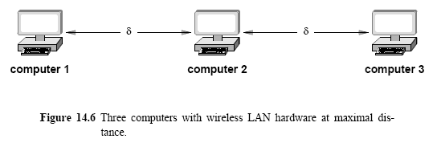
CSMA/CA
For computer 1, computer 3 may not be visible. So when computer 1 and computer 3 transmit at the same time to computer 2, it will detect a collision. It is called the “hidden station” problem.

Slide 20
CSMA/CA
Wireless uses collision avoidance rather than collision
detection
Transmitting computer sends very short message to receiver
Receiver responds with short message reserving slot for transmitter
Response from receiver is broadcast so all potential transmitters receive reservation

Slide 21
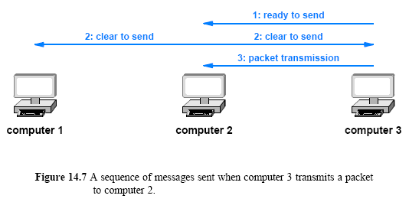
CSMA/CA

Slide 22
Collisions
Receiver may receive simultaneous requests
Results in collision at receiver
Both requests are lost
Neither transmitter receives reservation; both use backoff and retry
Receiver may receive closely spaced requests
Selects one
Selected transmitter sends message
Transmitter not selected uses backoff and retries

